Slide 1
Car Pooling
Esteban Aguirre García
esteban.aguirre-garcia@mailbox.tu-dresden.de
Collective Dynamics of Human Mobility
Summer Semester 2024
K0200-XColDMV PHY

Slide 2
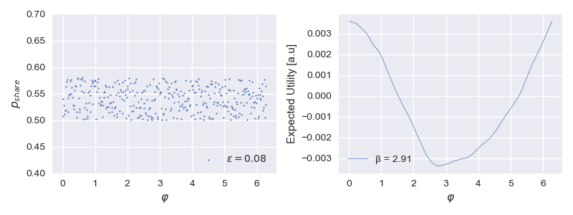
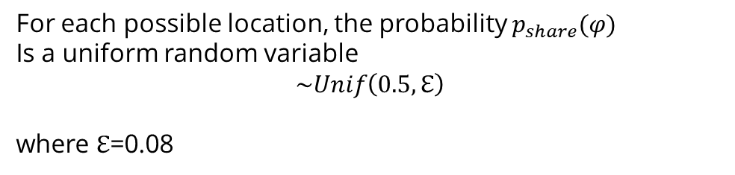
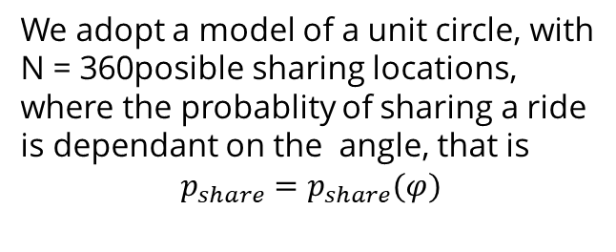
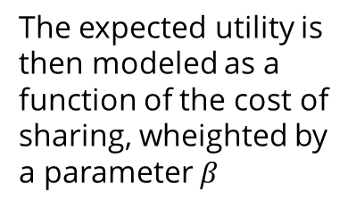
The expected utility is then modeled as a function of the cost of sharing, wheighted by a parameter $β$
We adopt a model of a unit circle, with N = 360posible sharing locations, where the probablity of sharing a ride is dependant on the angle, that is
$$p_{share}=p_{share}(φ)$$
For each possible location, the probability $p_{share}(φ)$
Is a uniform random variable
$$\sim Unif\left(0.5,ℇ\right)$$
where $ℇ$=0.08

Slide 3
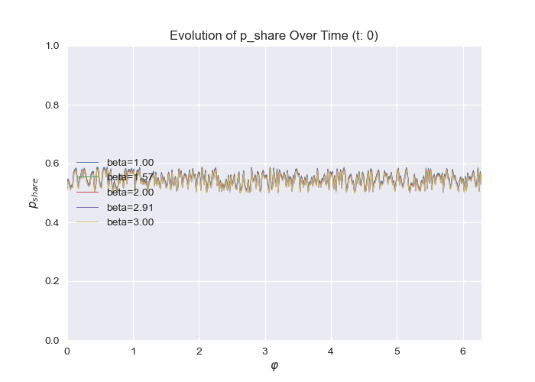
We consider the propagator equation for different values of beta to obtain the evolution of the utilities of sharing

